Slide 1
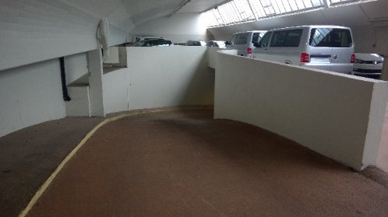
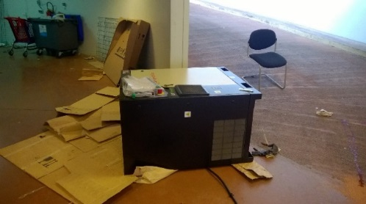
HS&E INCIDENT BULLETIN |  | 2nd half year 2016
France | Hit by object
Summary:
Techs were deployed at customer to prepare compressors for transport. Compressors were located on the 1st floor, to speed up the job they decided to use manual pallet truck to move the compressors to the ground level. While moving the compressor down the slope, the compressor slid off and hit the head of one of the techs. He sustained a serious head injury.
Root Causes: | Actions Taken Thus Far: Next Steps
Poor hazard recognition and stop work culture. Cutting corner to speed up the job. EE positioned himself in the line of fire Wrong tool selection (pallet truck) No procedure to assess non-routine jobs or new customer sites before mobilization | Define & implement comprehensive Safety Culture Improvement program Update job-planning procedure Update pre-job risk assessment Training of general manual handling / lifting

